Slide 1
A Short Typescript(Javascript) top-up

Slide 2
TS Features
The following features are used in the labs/examples
Destructuring
Spread Operator
Default Arguments
Array methods

Slide 3
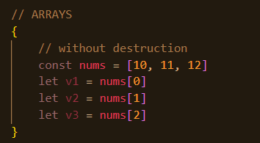
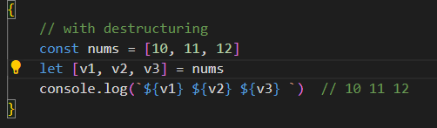
Destructuring
The active selection you've provided, ${v1}, is a template literal in JavaScript and TypeScript
The active selection you've provided, ${v1}, is a template literal in JavaScript and TypeScript
Assigning the properties of an array or object to variables using a declarative style rather than an imperative/procedural style.
See 01_destructing.ts
Template Literal. A way of output variables in the string
Notes:
Destructuring in JavaScript and TypeScript is a feature that allows you to unpack values from arrays, or properties from objects, into distinct variables. This can make your code more readable and maintainable by reducing the need for repeated references to the original array or object.
The active selection you've provided, ${v1}, is a template literal in JavaScript and TypeScript

Slide 4
The Spread Operator
JS arrays and objects are iterables.
The spread operator allows an iterable to expand in places where 0+ arguments are expected.
Syntax:
…arrayRef …objectRef

Slide 5
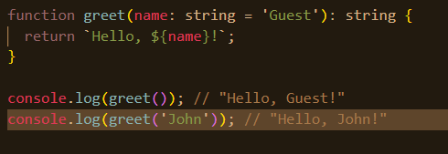
Default arguments

Slide 6


Array Methods
find(…) returns the value of the first element in the array where predicate is true, undefined otherwise.
map(…) executes a callback function on each element of an array, and returns an array that contains the results.
Filter(…) returns the elements of an array that meet the condition specified in a callback function.

